Slide 1


Senior Design Project: Color Filter
By Ezequiel Villanueva & Logan Doizaki
Notes:
Introduce yourselves

Slide 2

Presentation Outline
Project Description 3
Development 6
Architecture 8
Cost 18
Challenges 19
Demonstration + Q&A 21
Optimization 20
Notes:
E

Slide 3
Project Description
Notes:
E

Slide 4
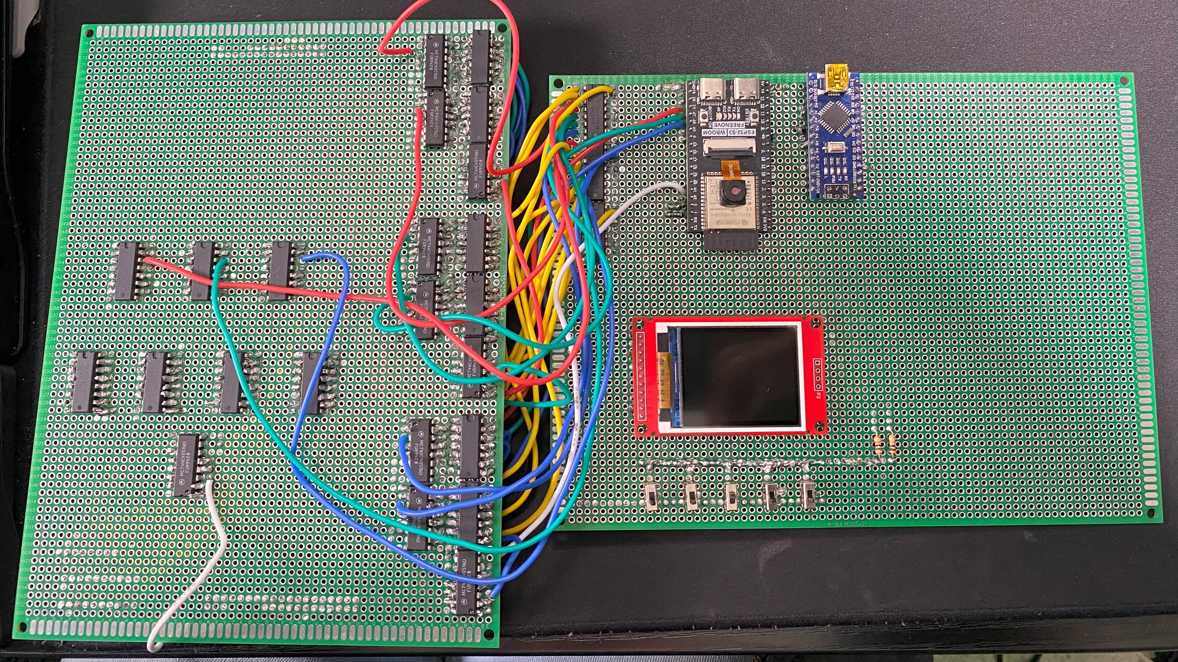
Overview
A device was developed to take a colored image captured by a camera and apply color manipulation.
By using user-based inputs, specific colors are filtered. The modified image is displayed to the user and stored internally. Alongside this, a greyscale filter feature was created to show greyscale rather than showing a black image when all colors are filtered out.
Notes:
L

Slide 5

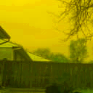
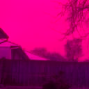
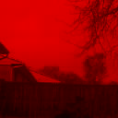
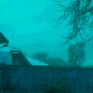
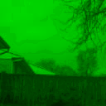
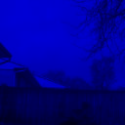

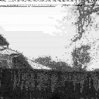
Examples
Color | Button 3 | Button 2 | Button 1 | Grayscale
RGB | LOW | LOW | LOW | LOW
RG | LOW | LOW | HIGH | LOW
RB | LOW | HIGH | LOW | LOW
RED | LOW | HIGH | HIGH | LOW
GB | HIGH | LOW | LOW | LOW
GREEN | HIGH | LOW | HIGH | LOW
BLUE | HIGH | HIGH | LOW | LOW
BLACK | HIGH | HIGH | HIGH | LOW
GRAY | X | X | X | HIGH
Notes:
L

Slide 6
Development
Notes:
E

Slide 7
OBJECTIVES FOR PROJECT
Setting up the microcontroller.
Color Filter
Grayscale
Finalizing Design
Notes:
E

Slide 8
Architecture
Notes:
E

Slide 9

Microcontroller
The Microcontroller serves to transmit and receive the image and user input information to their respective location.
Notes:
E

Slide 10
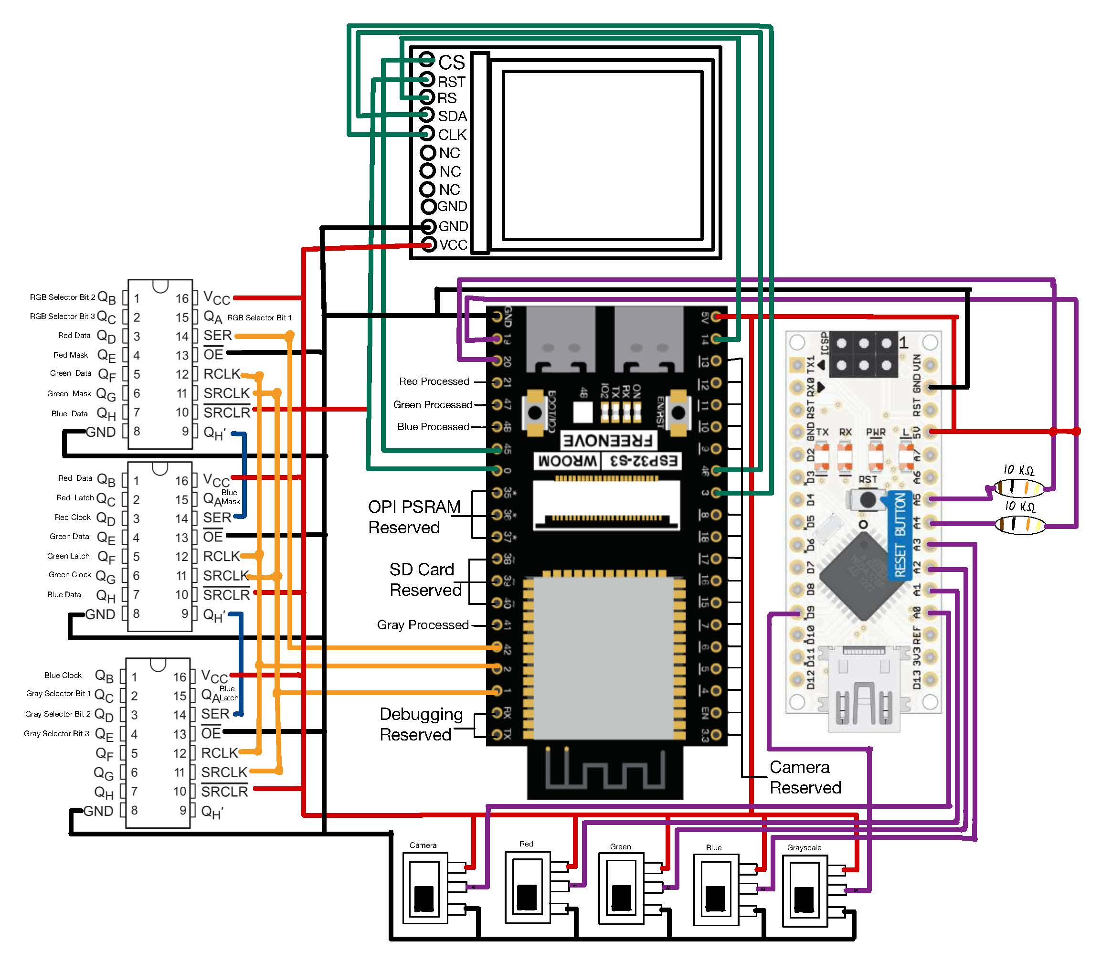
MCU (Circuit)
MCU for transmission and receiving data between all components
Second MCU for more pin outputs
Using shifter registers to increase pin outputs by sending bit strings
Switches controlling what colors are filtered out
LCD screen for display
Resolution is 128p X 128p
Notes:
L

Slide 11
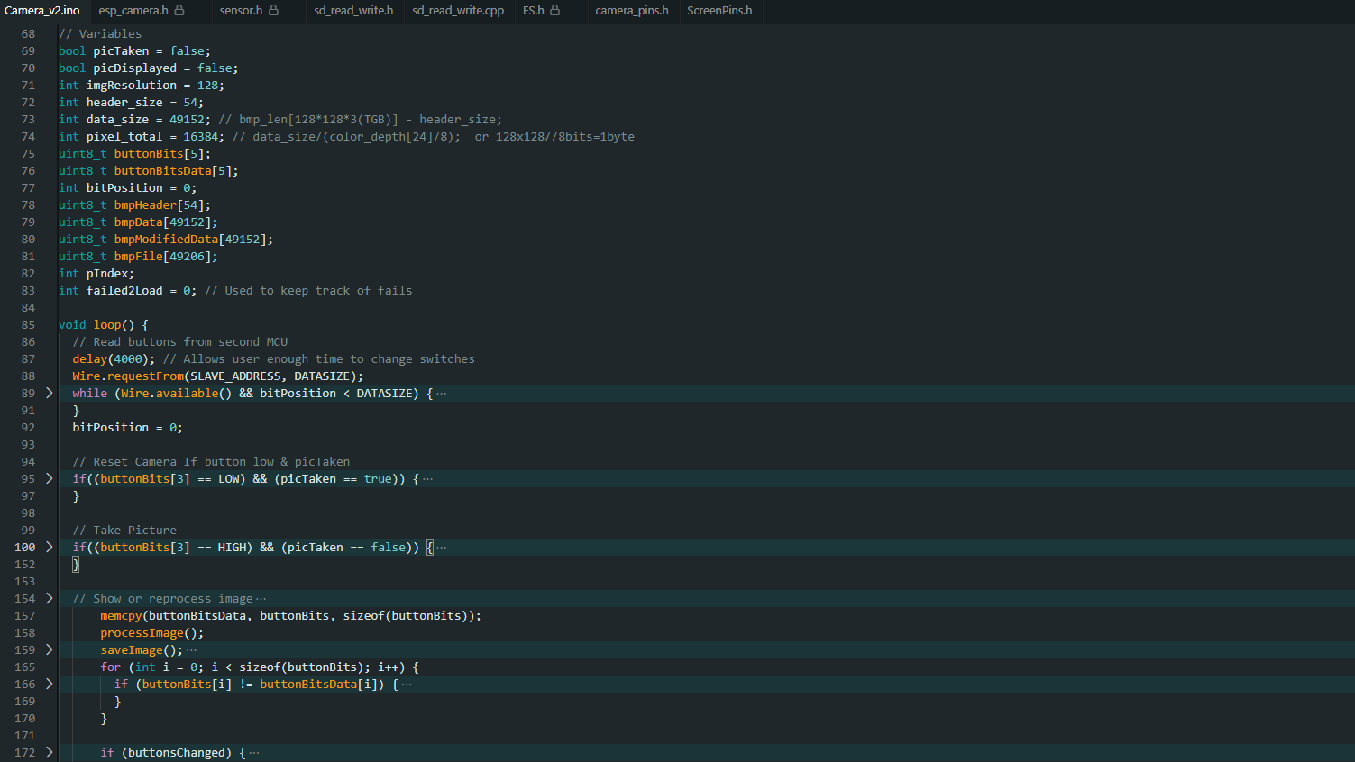
MCU (CODE)
Takes JPEG image and converts to Bitmap
Extracts header and image data
Transmit Image Data and Filtering Information
Receives Filter Image Data
Reconstructs the Image in Parts with Multiplexers
Stores Images to SD Card which can be accessed on PC
Notes:
E

Slide 12
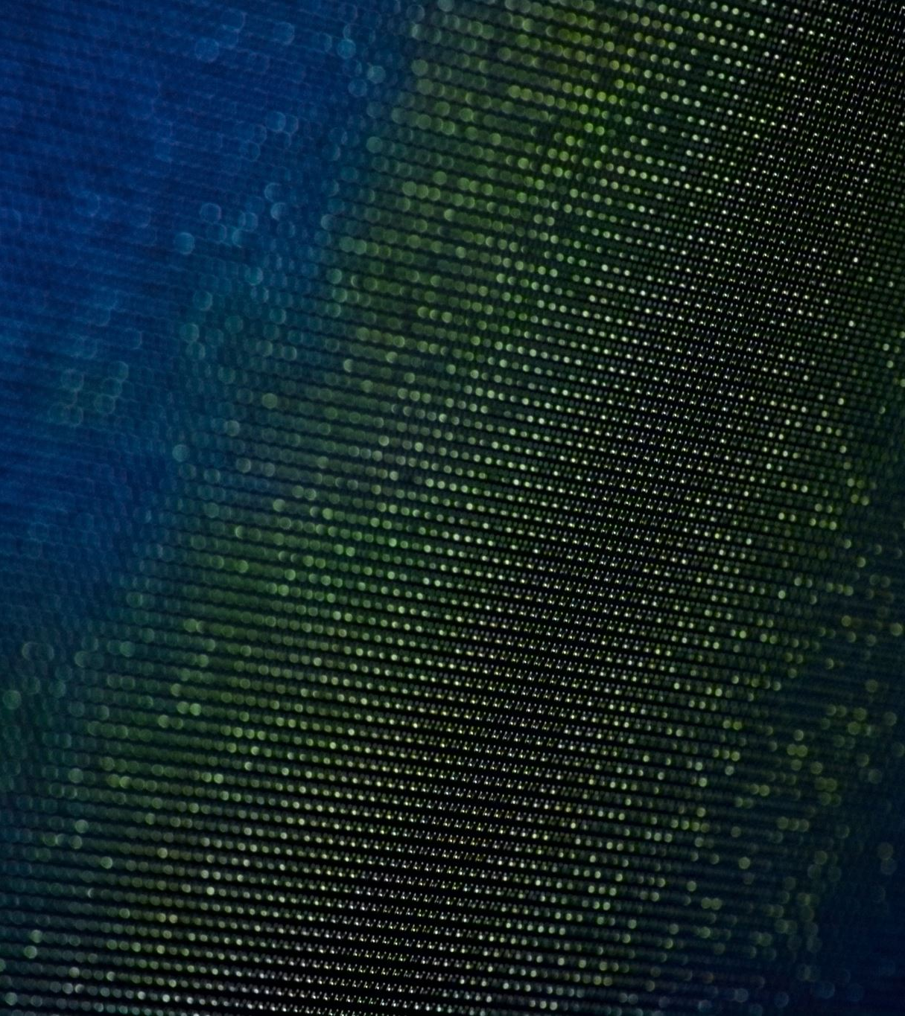
Color Filter
The Color filter utilizes logic masks to filter out specified colors
RGB information that consists of 24-bit color data per pixel.
Logic gates combined with masks
Notes:
L

Slide 13
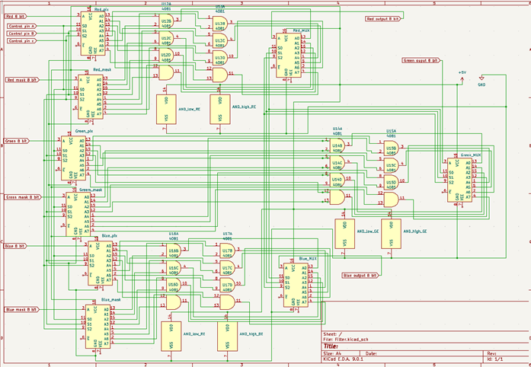
Color Filter (Circuit)
The circuit is built with AND gates, Demultiplexers, and Multiplexers.
The Demultiplexers are used to deconstruct 8-bit color data into its individual bits
The AND gates are used to apply a mask to filter out the user selected colors.
The Multiplexers is used for reconstruction of the signal.
Notes:
E

Slide 14
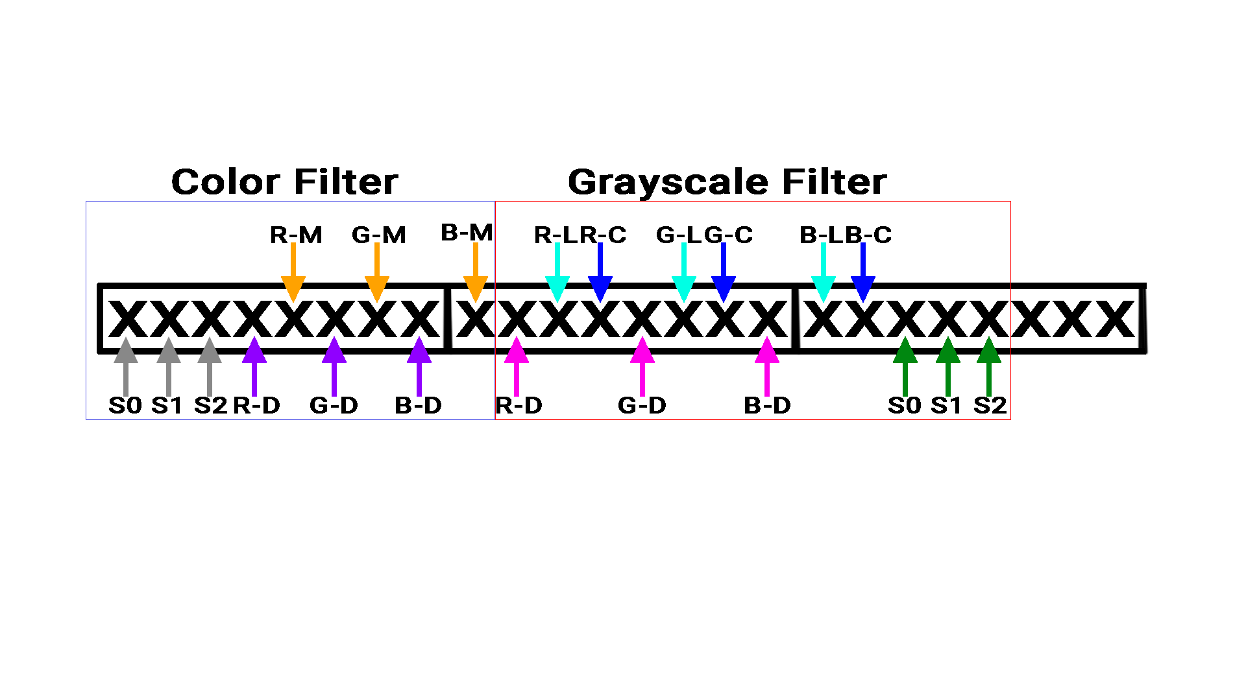
Color Filter (CODE)
The image taken by the MCU is broken into segments containing the file information and image data.
The image data is then transmitted to the color filter through a daisy chain of Shift Registers along with selector bit and mask information to indicate the bit position and filtering to be applied.
Once all three 8-bits are sent in parallel, the MCU reads the image provided by the Multiplexer and rebuilds the image 24 bits at a time.
Notes:
L

Slide 15

Grayscale
Greyscale is the representation of color using different shades of gray.
Greyscale is achieved by converting the 24-bits RGB data into 8-bit greyscale data
Since the amount of bits are reduced, there is some data loss.
Greyscale formula: Gray = (0.299 * Red) + (0.587 * Green) + (0.114 * Blue).
Notes:
E

Slide 16
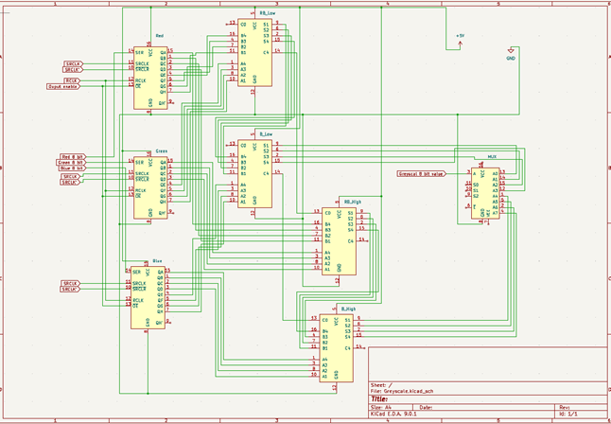
GRAYSCALE (Circuit)
The circuit is built with Shifters, Full Adders, and a Multiplexer.
The Shifters and Full Adders are used to perform the gray scale conversion.
However, the conversion has a marginal error
Gray = (0.25 * Red) + (0.5* Green) + (0.125 * Blue).
This arithmetic is performed by doing bit division through the Shift Registers and addition through Full adders
The Multiplexer is used to reconstruct the image
Notes:
L

Slide 17
GRAYSCALE (CODE)
The image taken by the MCU is broken into segments containing the file information and image data.
The image data is then transmitted to the color filter through a daisy chain of Shift Registers along with selector bit and mask information to indicate the bit position and filtering to be applied.
Once all three 8-bits are sent in parallel, the MCU reads the image provided by the Multiplexer and rebuilds the image 24 bits at a time.
Notes:
E

Slide 18
Part | Cost
ESP32-S3-WROOM CAM Wireless Board | 26.04
Arduino Nano | 15.99
DSD TECH 1.8 Inch TFT LCD Display Module | 9.99
Switches/Buttons | 7.99
MicroSD | 14.99
De/Multiplexers | 10(0.65) = 6.50
Full Adders | 4(1.86) = 7.44
Shifters | 6(1.05) = 6.30
AND Gates | 36(0.42)= 15.12
Resistor Variety | 9.99
Prototype Board | 19.99
Solder Wire | 2(9.59) = 19.18
22 AWG Stranded Wire Spool Multicolor | 19.99
Tax(20%)+Shipping Estimate ($20) | 35.90+20
Total | $235.41
COST
Notes:
L/E

Slide 19
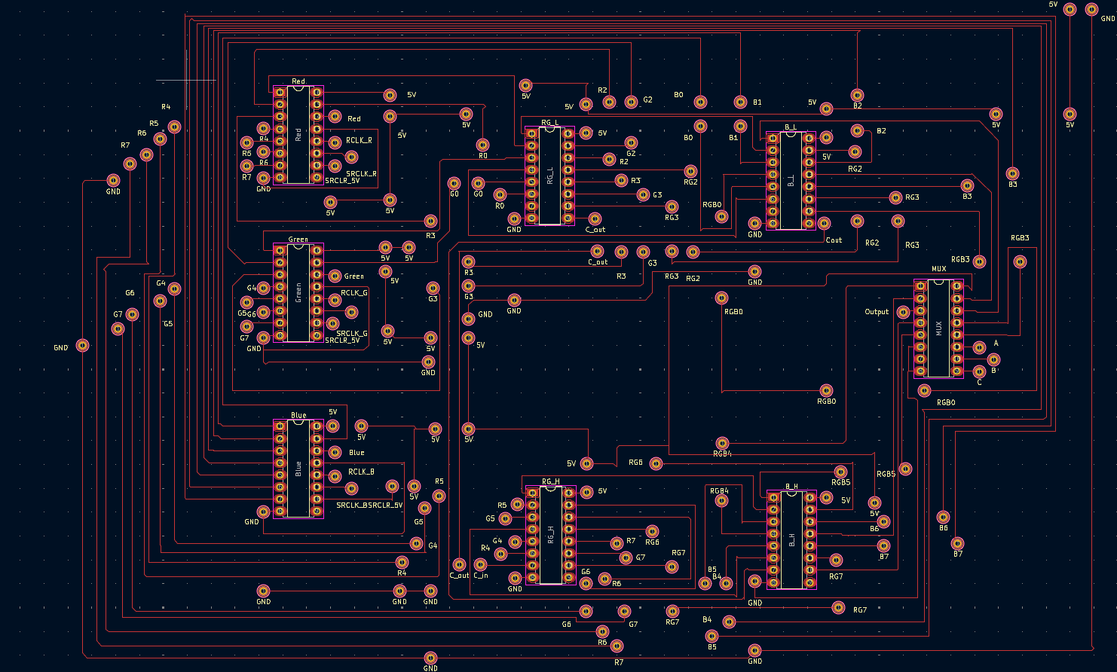
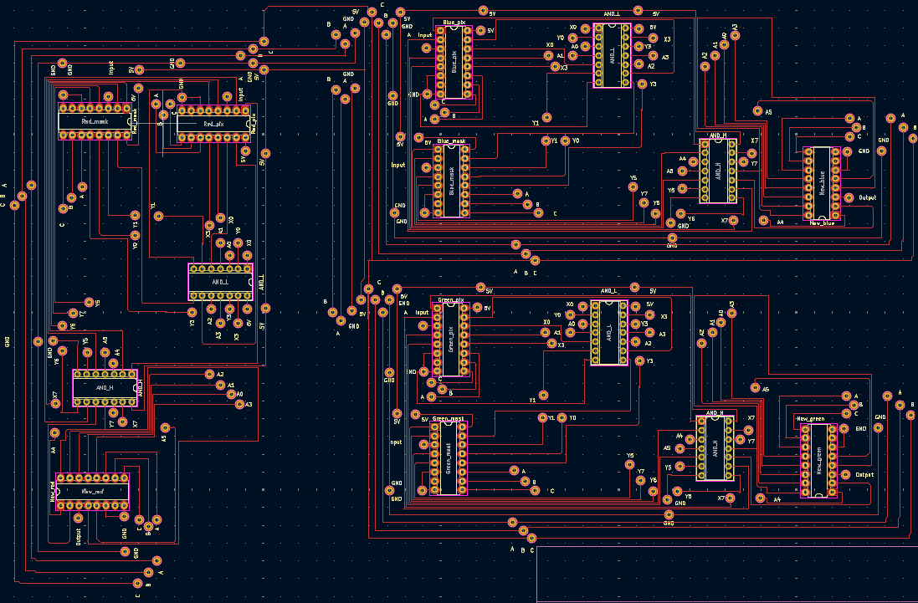
Challenges ENCOUNTERED
Circuit
PCB machine issues
More time
Running Out of Pins
Shifters with bit strings
Understanding Datasheets for Components
Doing simulations of parts
Multiplier is too expensive, hard to replicate
Using shifters
Shifters only shift to the left
Inversing twice
MUX
Not possible to do the full reconstruction
Faulty Soldering
Circuit building program issues
Finding components
Making it look clean
Code
Running out of Storage. MCU only has 512 KB
External RAM provided by OPI PSRAM
Misreading User Inputs
Added Delay/Store data

Slide 20

Optimization
Reduce Processing Time:
RGB: ~45.2 Seconds
Gray: ~72.1 Seconds
Future Project Ideas:
Adding more controllability
Amount of filtering
Recoloring
Live Feed Capability

Slide 21

Q&A
Got Any Questions?
Demonstration + Q&A
Notes:
Demonstration Here
- SD

Slide 22
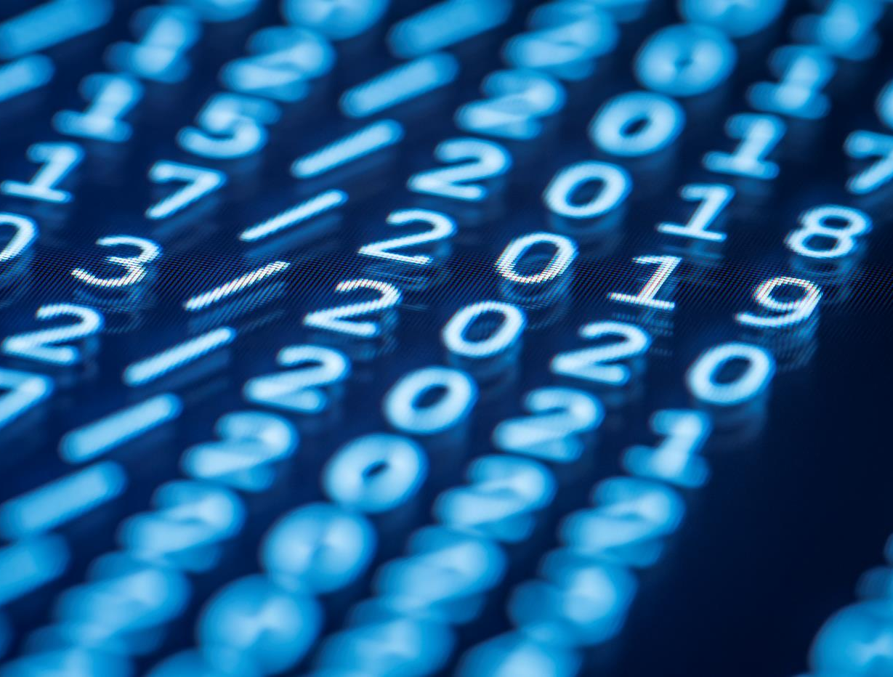
Thank You
Email us: evillan5@msudenver.edu
ldoizak1@msudenver.edu

